Slide 1

Election Management System Overview

Slide 2
Bold’s Election Management System (EMS) Overview

Slide 3






Bold’s Election Management System at a Glance
Purpose-built for your team, Bold streamlines every step of the voter check-in process from setup to reporting
One Complete EMS Solution
Bold’s EMS powers every phase of your election from setup to sign-off with the reliability, speed, and support you deserve
Pre-Election Setup
Post-Election & Reporting
Bold’s comprehensive pre-election tools streamline the setup process and ensure a seamless start to Election Day
Bold simplifies your post-election closeout with tools to reconcile poll lists, track voter history, and generate audit-ready reports in minutes
On Election Day
Support & Training
Bold keeps Election Day running smoothly with intuitive check-in tools, built-in fail-safes, real-time reporting, and regional poll reps ready to support your team on-site
Bold is with you at every step, offering unlimited training, live support, and election-tested guidance to keep your team confident and in control

Slide 4




Election Ready, Well Before Election Day
We don’t just show up on Election Day – Bold is with you every step of the way
Voter Database Maintenance
Combine and manage in-district and county voters in a single system, updated year-round, with expertise in complex multi-county configurations
Absentee & Special Voter Tools
Track early mail voters, permanently sick, military, and requested absentees with built-in label creation and checklists
Public-Facing Voter Access Tools
“Poll Place Finder” and “Am I Registered?” links embed directly on your district’s website
Unlimited Pre-Election Training
Bold offers ongoing software walkthroughs and full election staff workshops at no additional cost
Off-Cycle Use & Planning Support
Use Bold EMS for budget votes, bond referendums, FOIL requests, and planning for special elections
Everything we do before Election Day ensures your election runs exactly as it should – smooth, secure, and supported

Slide 5





All Systems Go: Bold is Your Election Day Command Center
From your first check-in to closeout, Bold keeps your election on track one voter at a time
Proactive Monitoring
Real-Time Reporting
Power, Wi-Fi, and device health are monitored and logged across all sites
EMS Pulse proactively monitors equipment health while real-time turnout data is streamed via EMS dashboard
Looking for trends / problems
All of our poll reps are logging things at your site, kiosk issues, monitoring power levels, wifi connectivity, ensuring you stay up
Not just a quick visit, on-prem poll worker education, if we find issues we ensure they aren’t trending across all of our schools
Instant trending, live election-day reporting
On-Site Poll Support
Help Desk Coverage
We train poll workers on-site to reinforce best practices and proactively resolve issues
Bold’s support team responds to calls on election day, with regional poll reps available for on-site assistance
Failsafe Technology
eBook Efficiency
Internet down? No Problem. Book Breakout Mode ensures full offline operation
Poll workers check in voters faster with a modern, intuitive user-interface
Every check-in, every issue, every voter – we are with you all day to keep your election running

Slide 6



Beyond the Ballot: Close Your Election With Confidence
From reconciliation to readiness, Bold helps you finish strong and plan ahead for the next election
Confidence Beyond Election Day
Bold’s EMS supports your team long after the last vote, giving you reliable access to data, reporting, and election insights whenever you need it
Reconciliation & Compliance
Ensure accuracy and transparency with instant reporting, poll list reconciliation, and audit-ready digital records
Year-Round System Access
Bold’s EMS can be used year-round to run reports, respond to FOIL requests, prep for audits, and manage future elections with confidence
Post-Election Tools & Reporting
Use EMS tools to finalize election status, track voter history and demographics, and identify trends across years and elections

Slide 7
Pre-Election Process Overview & EMS User Interface

Slide 8




Seamless Elections Start with Bold
Bold keeps your election on track every step of the way
Pre-Election Preparation
Bold Prepares Your Voter Data
Bold Pre-Loads Your eBooks
Bold Delivers Your Equipment
Bold Trains Your Team
Bold Provides the 10-Day Addendum
Key Activities:
Bold processes and prepares your district’s registered voter data to ensure accuracy before Election Day
Bold pre-loads all your eBooks with voter data and polling location assignments before delivery
Bold ensures every location receives eBooks, chargers, styluses and supplies about a week prior to Election Day
Bold provides live and virtual trainings to ensure every poll worker and clerk is confident and ready for Election Day
Bold enables a simple refresh the Friday before Election Day, syncing your eBooks in minutes
Proven Reliability
25+ years of experience supporting thousands of elections
Real-Time Reporting
Live check-in data flows immediately into your dashboards
Failsafe Connectivity
Book Breakout Mode⁽¹⁾ and built-in safeguards ensure no technical issues can slow down voter check-ins
On-Site Support
Bold’s poll reps deliver last-minute training to ensure your staff is ready for Election Day
Effortless Setup
Finalized in minutes, a simple update ensures your eBooks are ready before the polls open
(1) Book Breakout mode enables poll workers to assign voters to an eBook by their last name to ensure voters cannot vote multiple times at the same location (details provided on slides 19-20).

Slide 9

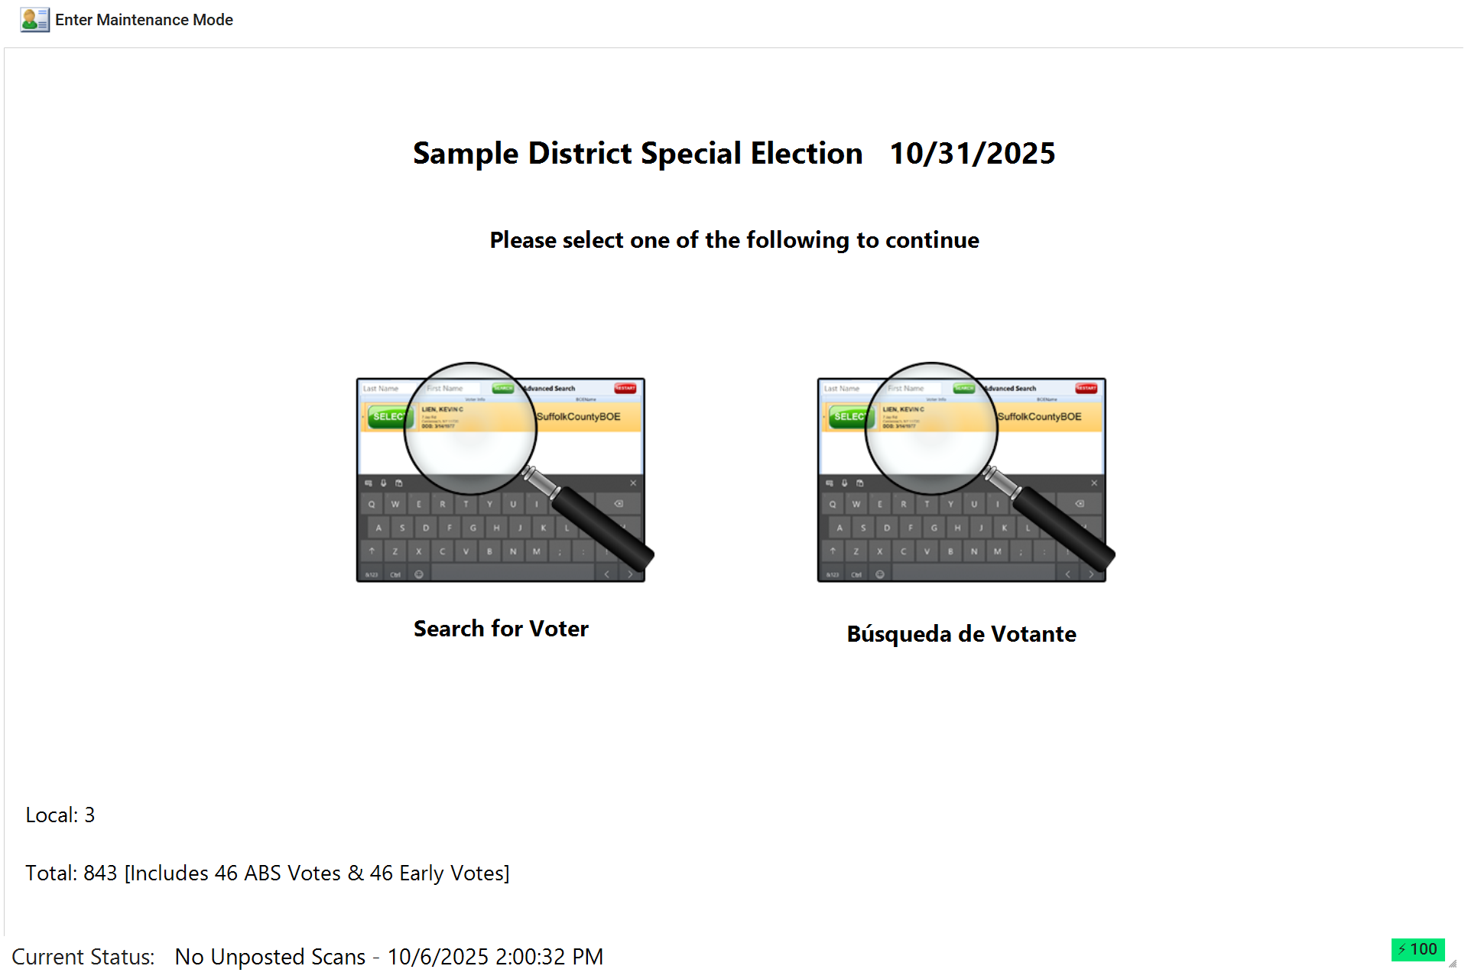




EMS User-Interface Overview: Home Screen
Designed for every role in your election team, Bold empowers every election official throughout the process
Ready from the Start
Poll workers can see how many voters have checked in on their device and whether the system is syncing properly. If the internet connection is lost, the screen displays in clear red text so staff can take action immediately
Continuously Monitored
Dual-Language Option
Proactive Battery Life Tracking
Local Machine Information
If the internet connection is lost, don’t fear, there’s no disruption to check-ins. All data is saved locally and will automatically sync to the server once the connection is restored so your election can continue as normal

Slide 10
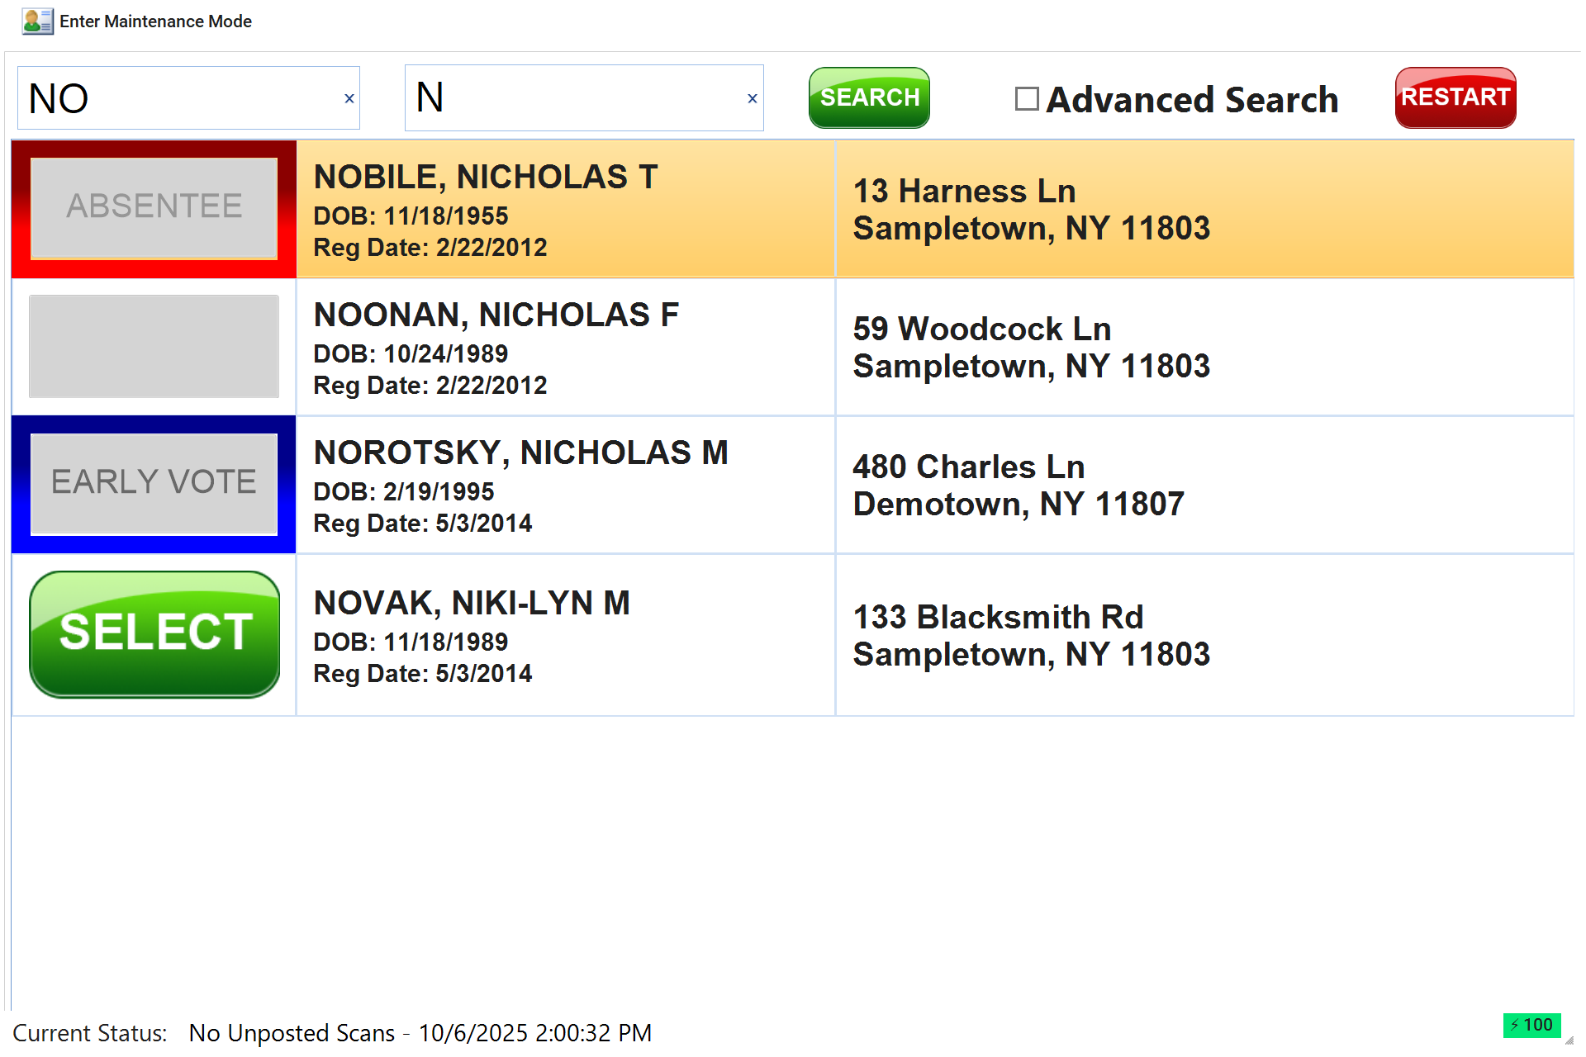




EMS User-Interface Overview: Voter Lookup (Single Polling Location)
Designed for every role in your election team, Bold empowers every election official throughout the process
Voter Check-In Made Easy
Bold's EMS simplifies the check-in process with intuitive screens, color-coded records, and large, accessible text aimed at keeping check-in lines moving
Intuitive Voter Search System
Large, Easy-to-Read Text
Voter Status Indicators
Clear Action Buttons
Bold’s eBooks are loaded with every active voter in your district and clearly display voter status to prevent duplicate voting. Early voters, absentees, and ineligible voters are blocked at check-in to ensure only eligible voters participate

Slide 11
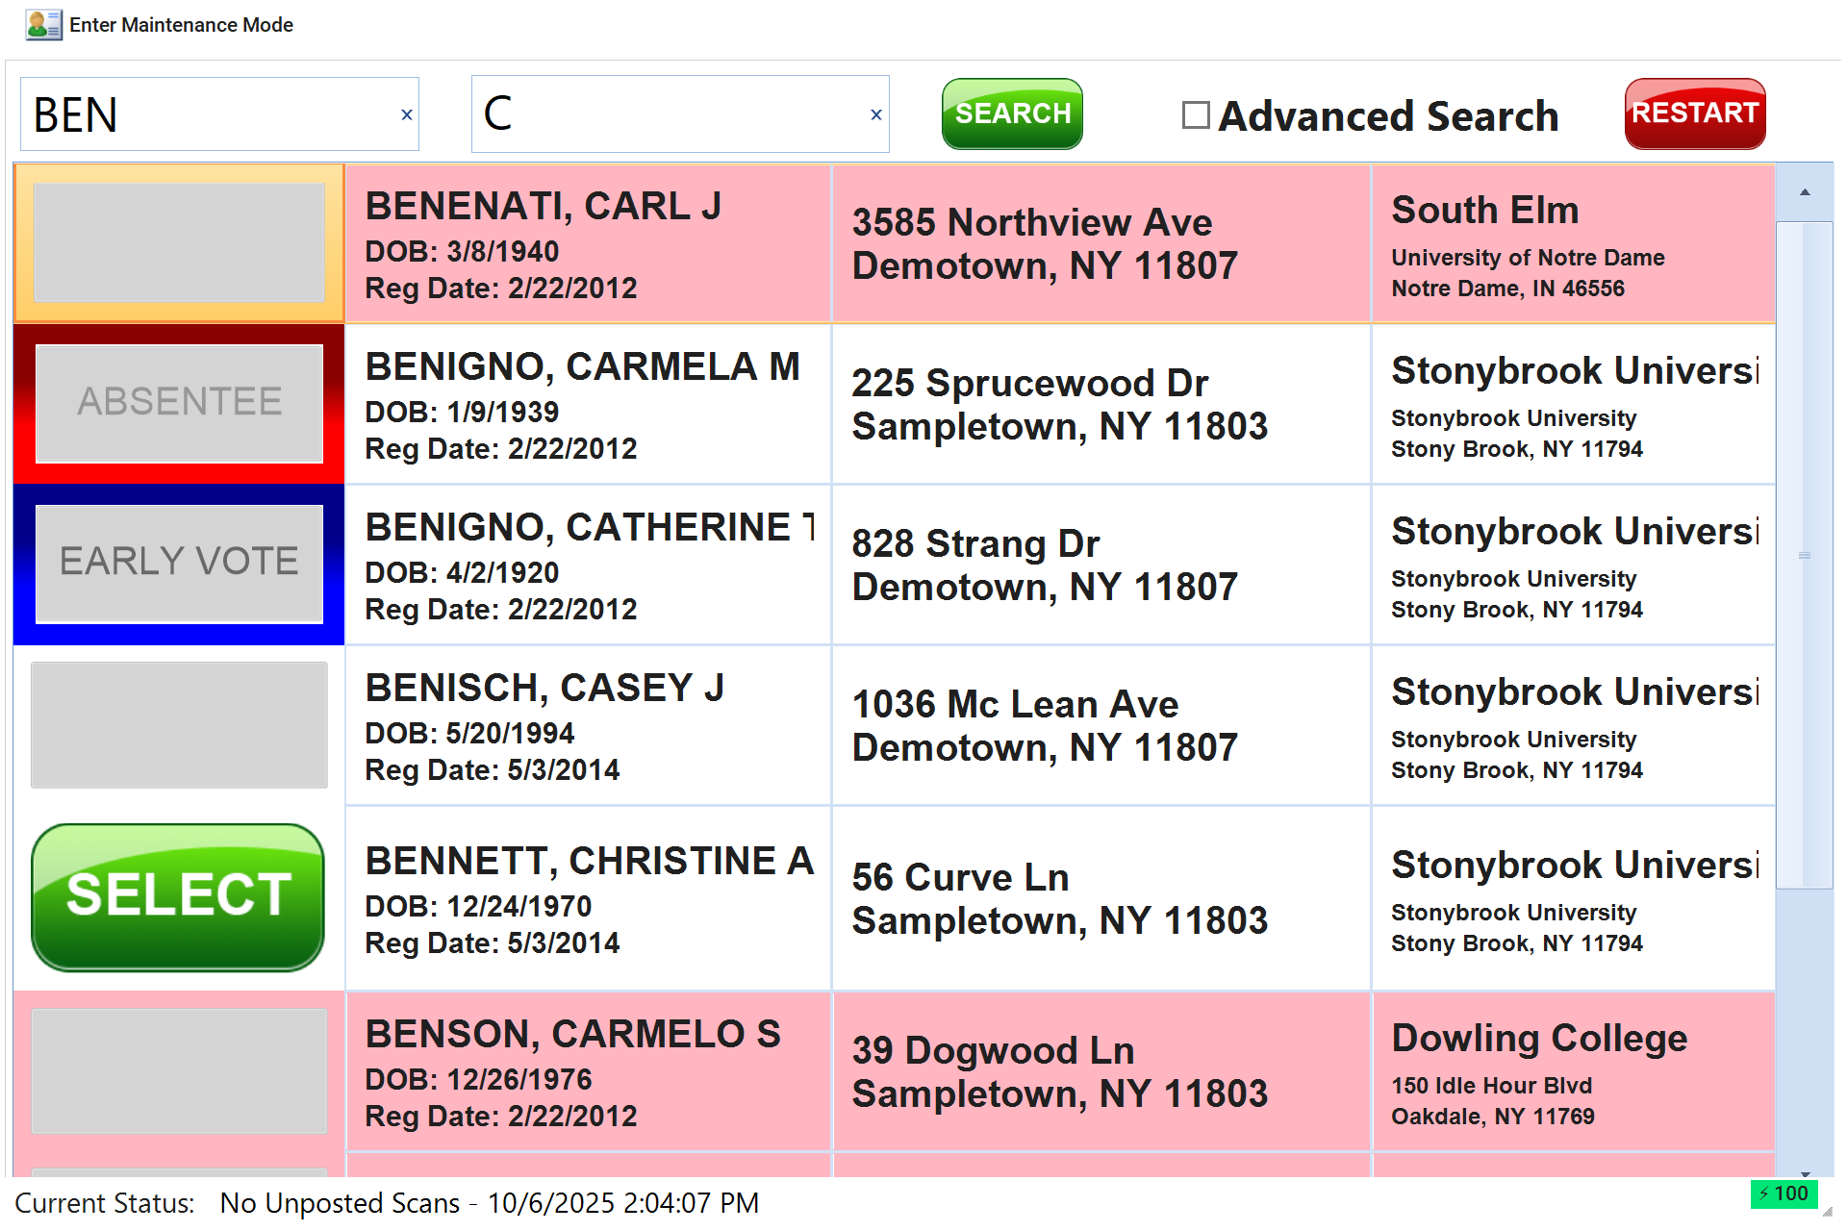

EMS User-Interface Overview: Voter Lookup (Multiple Polling Locations)
Designed for every role in your election team, Bold empowers every election official throughout the process
Voter Check-In Made Easy
Bold's EMS simplifies the check-in process with intuitive screens, color-coded records, and large, accessible text aimed at keeping check-in lines moving
Intuitive Voter Search System
Large, Easy-to-Read Text
Built-In Polling Location Logic
Clear Action Buttons
Bold’s eBooks are loaded with every voter in your district and know each voter’s polling place. If a voter arrives at the wrong location, the eBook clearly shows their correct site so poll workers can redirect them on the spot

Slide 12
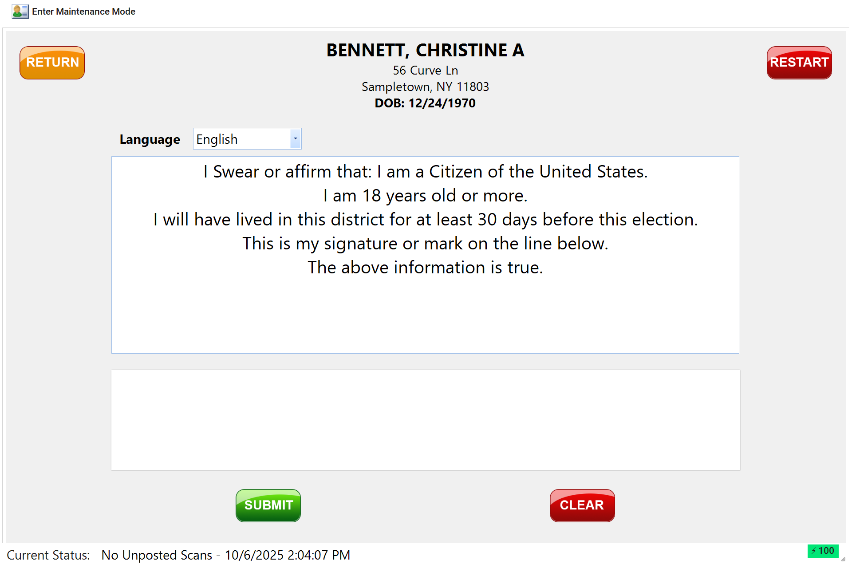



EMS User-Interface Overview: Voter Affirmation
Designed for every role in your election team, Bold empowers every election official throughout the process
Simple Voter Affirmation
Once a voter is selected, the affirmation screen appears automatically. Voters can review and affirm eligibility in their preferred language, sign digitally, and submit in the eBook
Automatic Affirmation Prompt
Language Toggle
Digital Signature
One-Tap Submission
Bold’s EMS ensures each voter signs their affirmation digitally, creating a complete and verifiable record without slowing down the check-in process

Slide 13
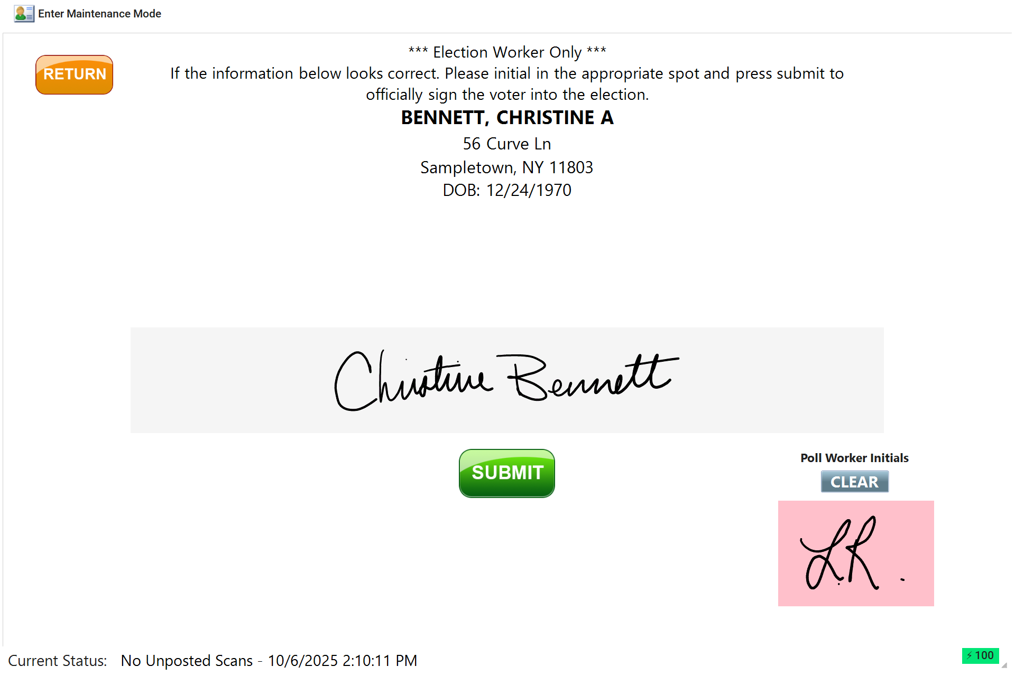



EMS User-Interface Overview: Signature Review
Designed for every role in your election team, Bold empowers every election official throughout the process
Secure Voter Check-In
After a voter signs their affirmation, the signature review screen allows poll workers to submit the check-in and initial the record while EMS builds a signature database for future use
Signature Review
Poll Worker Initials
Check-In Submission
Audit-Ready Record
Bold’s EMS creates a complete, verifiable check-in record by capturing both the voter’s signature and poll worker’s initials; ensuring every record is complete and ready for post-election reporting

Slide 14
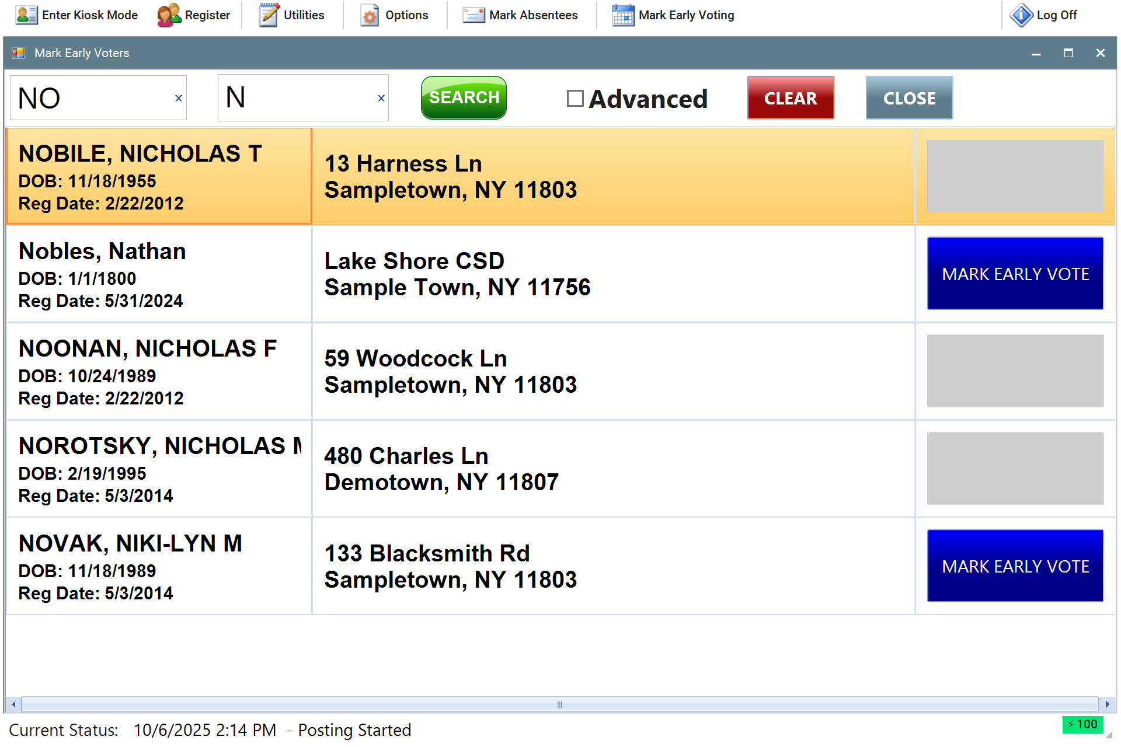
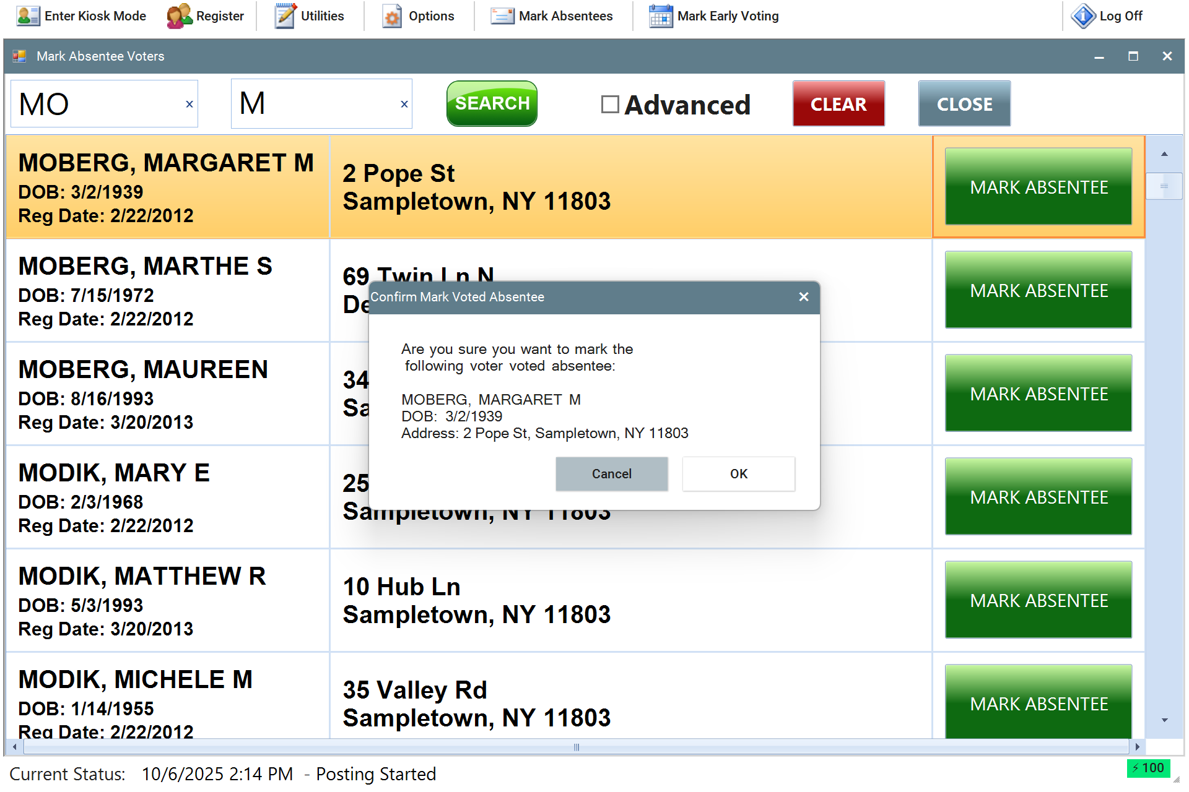



EMS User-Interface Overview: Absentee & Early Voter Tracking
Designed for every role in your election team, Bold empowers every election official throughout the process
Voter Status Management
Bold’s EMS allows users to pre-mark voters as absentee or early before Election Day. Once marked, these voter statuses are instantly visible to poll workers at check-in ensuring accurate records and preventing duplicate voting
Pre-Marked Voter Status
Visible at Check-In
Prevents Double Voting
Maintains Data Integrity
Managing absentee and early voters in EMS gives your election team complete visibility and prevents duplicate voting. It’s seamless for poll workers and built to maintain record integrity across all voter statuses

Slide 15
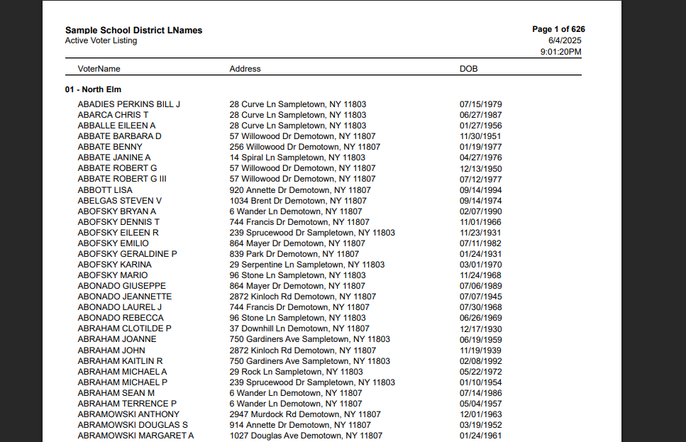
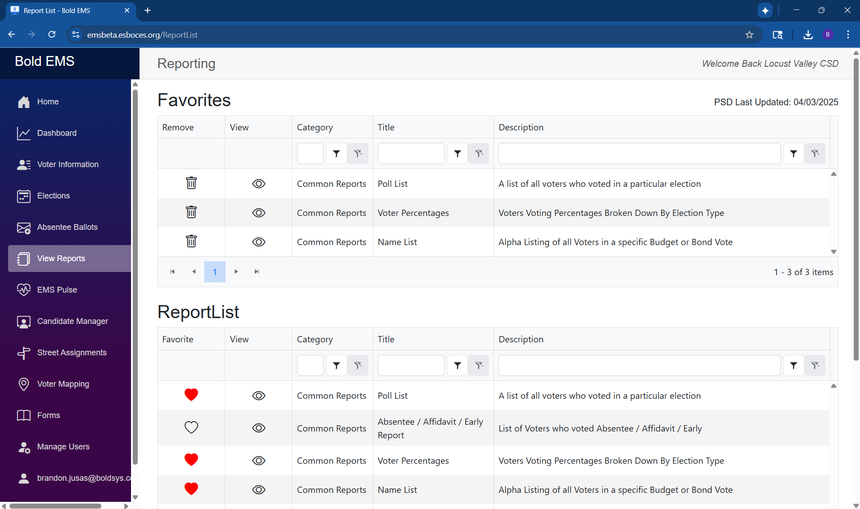




EMS User-Interface Overview: Common Reports
Designed for every role in your election team, Bold empowers every election official throughout the process
Comprehensive Reporting
Bold’s EMS delivers comprehensive election reporting including active voter lists, poll lists, voter turnout, and demographics that enable you to quickly respond to FOIL requests and gain valuable election insights
FOIL Ready
Complete Coverage
Flexible Export Options
Real-Time Access
From basic voter lists to complex election analysis, Bold’s reporting suite covers every aspect of your election. Whether you need quick answers for transparency requests or insights for future elections, Bold’s reports deliver the information you need when you need it

Slide 16
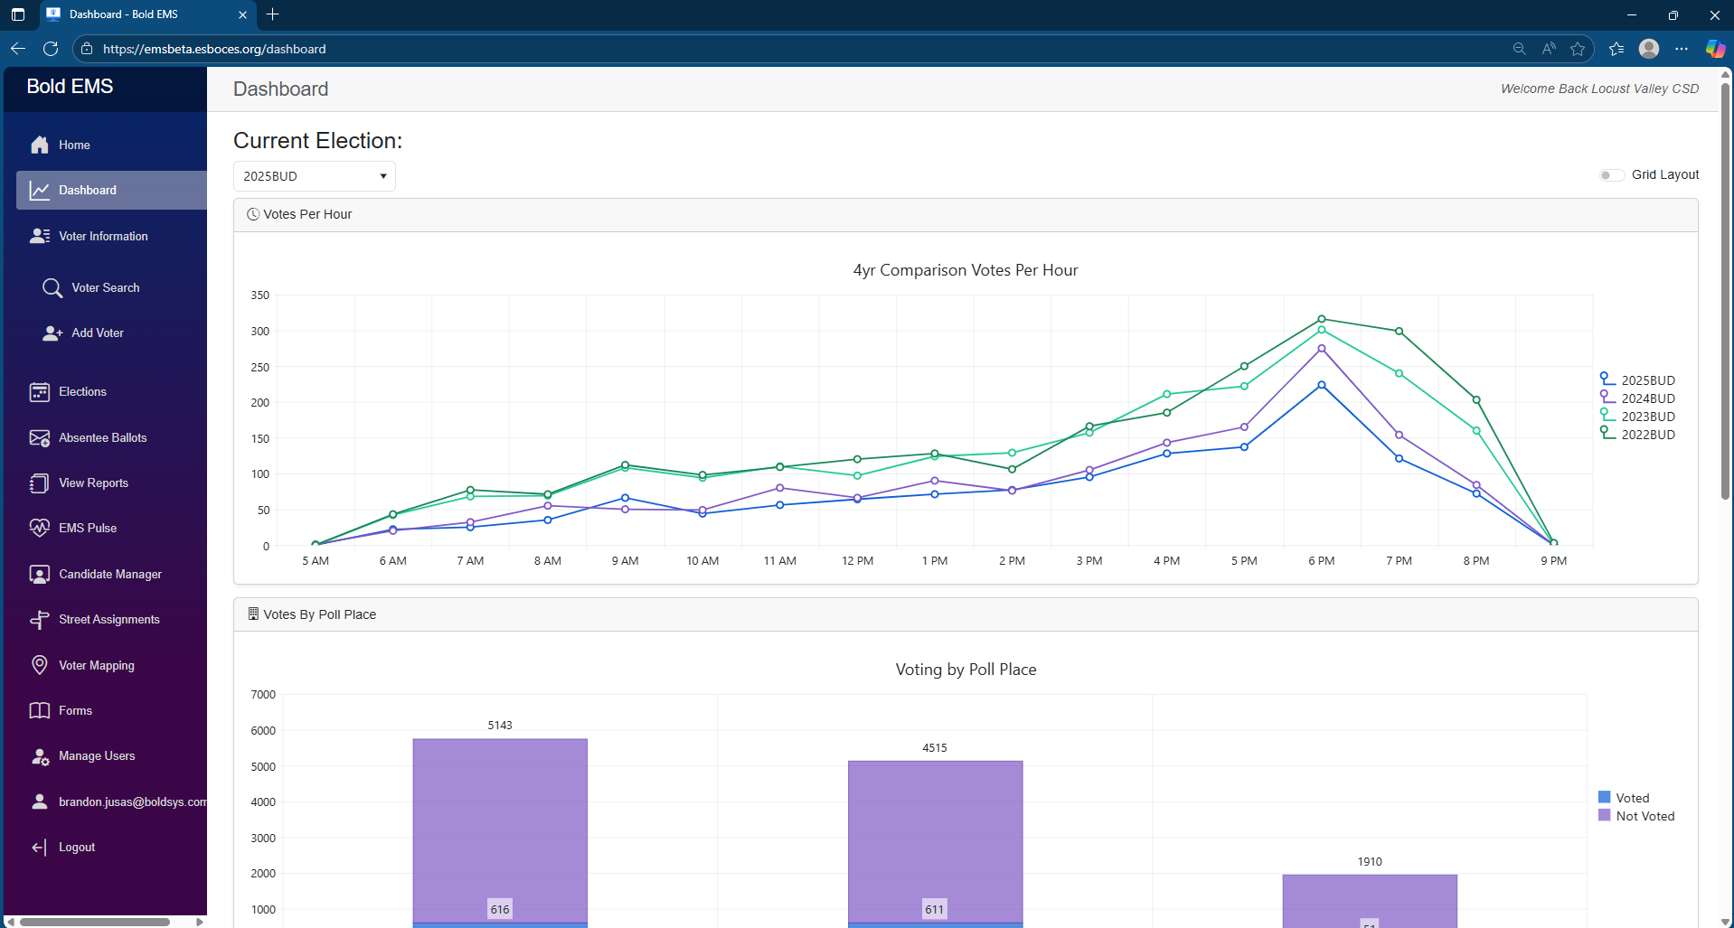
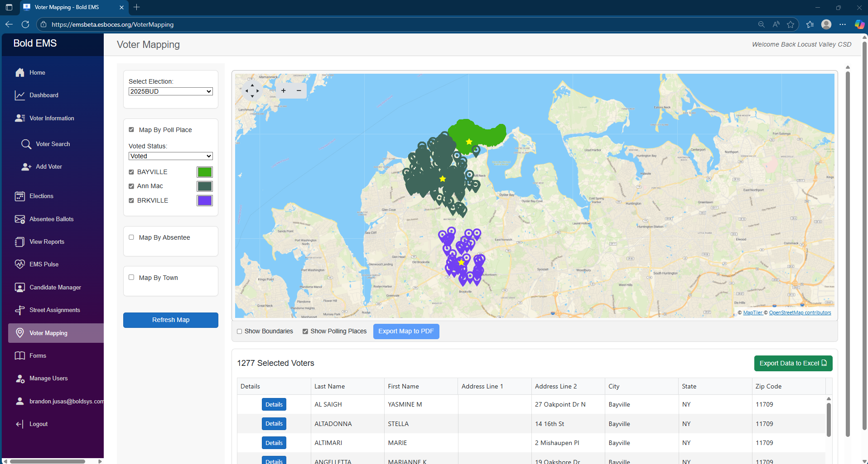




EMS User-Interface Overview: Dashboards (Voter Mapping & Votes per Hour)
Designed for every role in your election team, Bold empowers every election official throughout the process
Visualize Voter Turnout
Bold’s dashboards bring your election to life with powerful, interactive maps and live turnout tracking. Instantly visualize voter check-ins and compare trends across years
Turnout Tracking
Trend Analysis
Interactive Voter Mapping
Strategic Planning
From first check-in of the day to final results, Bold’s dashboards give you the visibility to manage your election with confidence. Watch turnout trends unfold live, compare performance to prior years, and pinpoint high-traffic sites all in one view

Slide 17
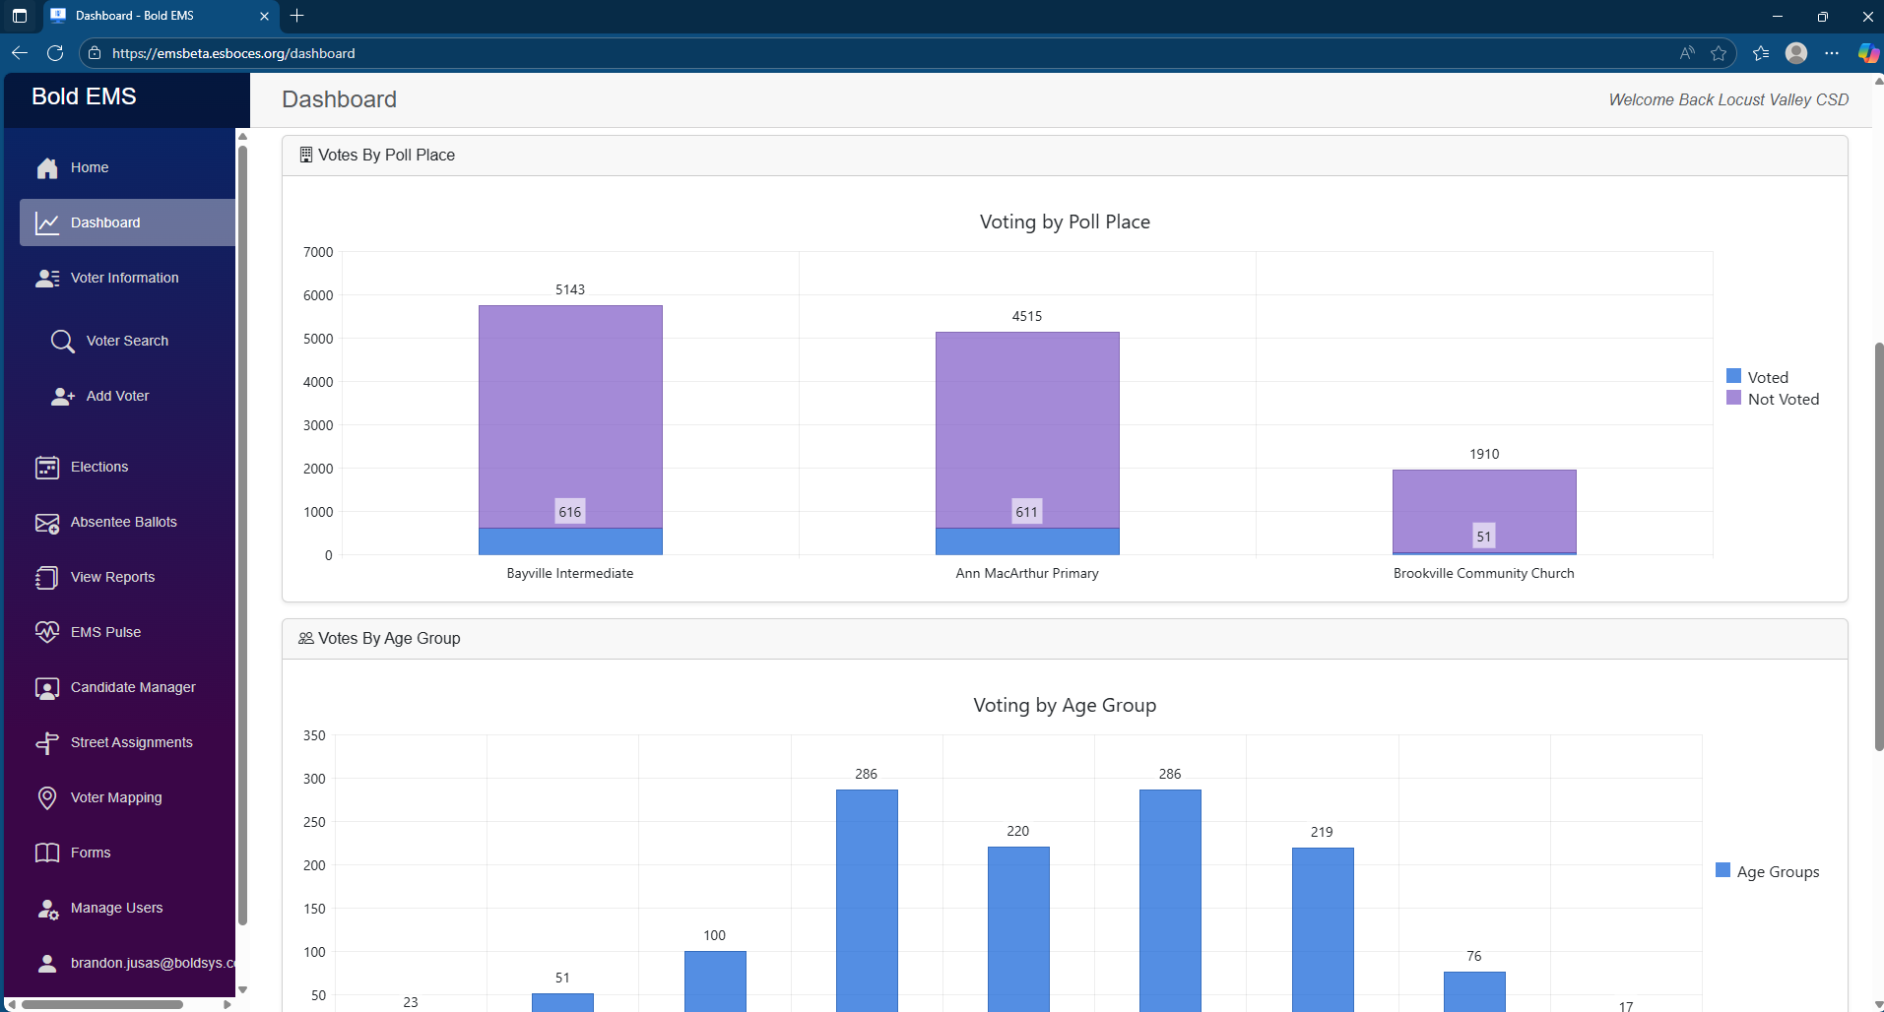
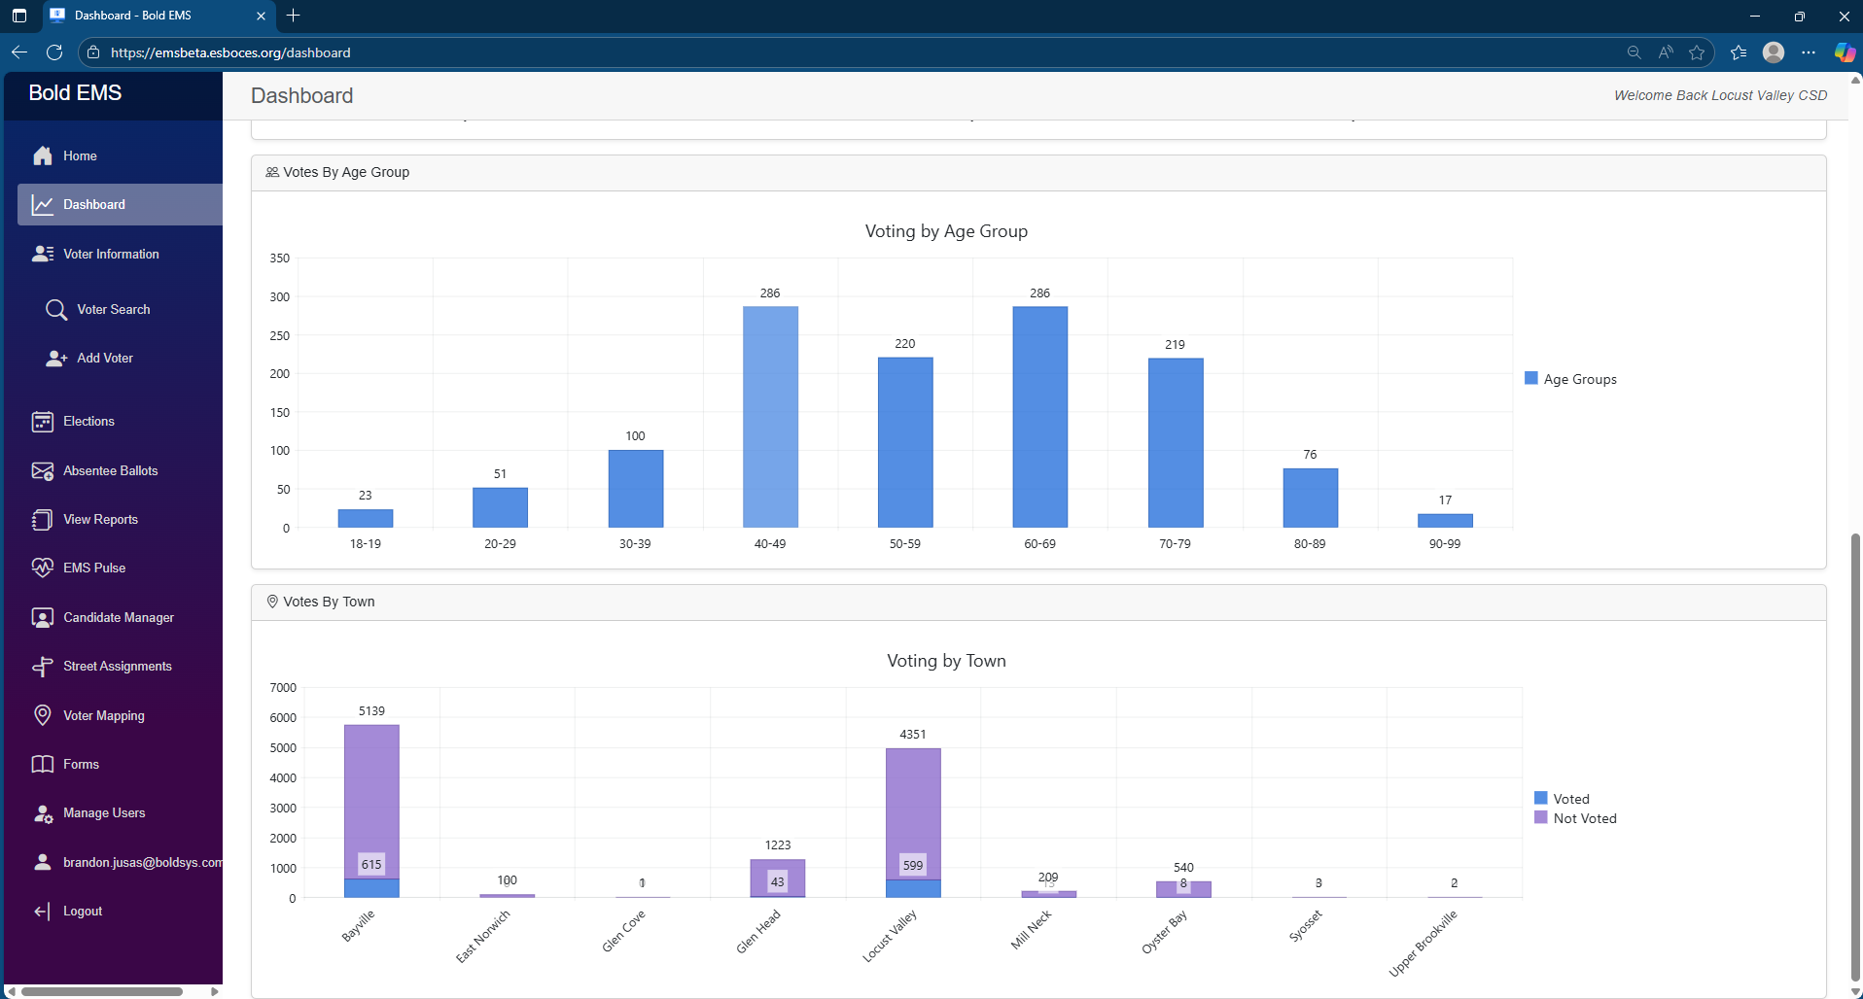




EMS User-Interface Overview: Dashboards (Votes by PP, Age Group, & Town)
Designed for every role in your election team, Bold empowers every election official throughout the process
Understand Voter Trends
Bold’s dashboards give you a clear picture of voter activity across every polling place. Instantly compare turnout between locations to identify patterns and allocate resources
Poll Place Insights
Turnout Comparison
Electorate Demographics
Resource Allocation
View voter check-ins by age group and town to uncover turnout trends, strengthen engagement strategies, and plan more effectively for future elections. From polling place performance to turnout analysis, Bold turns data into election intelligence

Slide 18
Book Breakout Mode

Slide 19





EMS Overview – Book Breakout Mode
Even when the internet goes down, your election doesn’t
Book Breakout Mode
What It Is
Built-in EMS failsafe for full connectivity loss
Converts each eBook into an independent poll book (similar paper books)
Keeps check-ins active with no downtime
When To Use It
Only during extended internet outages
For short internet drops, check-ins store locally and auto-sync upon re-connection
Why It Works
Sorts voters by last name to prevent duplicate voting (i.e. A-K, L-Z)
Stores data locally until reconnection
Automatically re-syncs to EMS
Book Breakout Mode
Key Benefits
No interruptions for voters or poll workers
Maintains full election integrity
Peace of mind when the unexpected happens
How To Activate
Tap the Book Breakout checkbox in EMS and follow the instructions
Bold’s Helpdesk can guide you through the process in minutes if needed
After Connectivity Restores
All data and signatures sync automatically
Reports and audit trail update instantly
The built-in backup that keeps your election moving under any condition

Slide 20
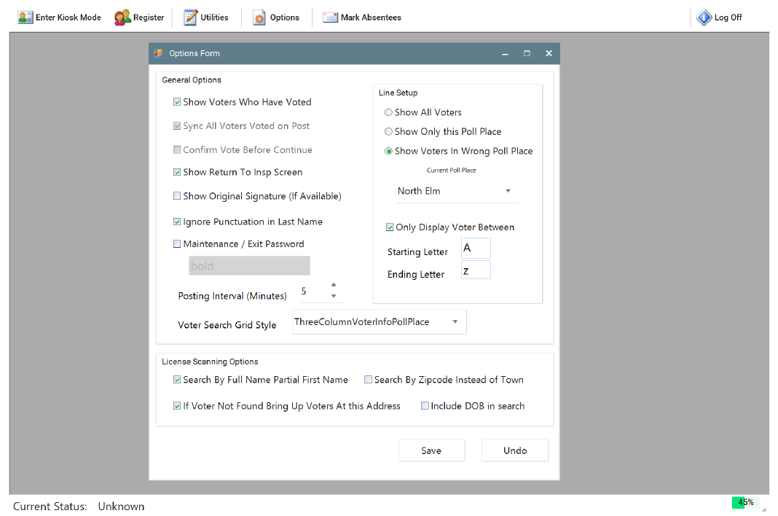

EMS User-Interface Overview: Book Breakout Mode
Designed for every role in your election team, Bold empowers every election official throughout the process
Election Day Failsafe
Bold’s Book Breakout Mode activates with the press of a button, converting your eBooks into organized digital poll books sorted by voter last name
One-Button Activation
Organized by Last Name
Zero Downtime
Bulletproof Backup
When connectivity fails, Bold’s Book Breakout Mode ensures your election continues seamlessly. Each eBook becomes an independent poll book with organized voter lists. When the unexpected happens, Bold keeps your election secure

Slide 21
Getting Started with Bold: Conversion Process & Conclusion

Slide 22





Getting Started with Bold: The Conversion Process
Regardless of how you’re running elections today, Bold works with your available data and handles the conversion process seamlessly
Conversion Data Requests
What Bold Builds from Your Data
Street files, polling locations, contacts and historical voter turnout data
Centralized EMS voter database, check-in structure, and user permissions for your election team
District Information
Street-level mapping of polling locations and zoning
Digital poll place assignments and zone-based check-in configurations
Polling Location Mapping
4 years of historical voter and poll list data
Preloaded voter history and advanced turnout reporting capabilities
Historical Election Data
County BOE voter file for cross-checking and validation
Clean, validated registration file combining county and in-district records
County BOE Review
Typical conversion takes 2-4 weeks once inputs are received
Turnkey EMS environment ready for pre-election reporting and deployment
Timeline & Support
From data intake to implementation, Bold will gather all the information to run your conversion so you don’t have to

Slide 23


Why School Districts Choose Bold
Trusted by school districts across New York, Bold delivers dependable elections, proactive support, and powerful tools to keep your team confident every step of the way
Proven Reliability Election after election, Bold gets it right “Bold makes elections stress-free. I never worry about something going wrong.” – District Clerk, Suffolk County
Exceptional Support Bold’s team is available, responsive, and ready to help “When I call, they pick up. On Election Day, that’s everything.” – Business Administrator, Capital Region BOCES
Powerful Reporting Live turnout, digital poll books, and instant exports when you need them “The dashboard makes post-election work effortless” – Superintendent’s Office, Central New York
25+ Year Track Record Thousands of elections run with unmatched expertise and attention to detail “Bold’s expertise shows – they know what to do before I even ask.” – Assistant Superintendent, Nassau County

Slide 24



Your District’s Election Process
Let’s learn more about how your district runs elections today
District Snapshot: Help us understand your operational requirements to design the right configuration – voter count, polling locations, towns covered, voter distribution, and geographic challenges
District Snapshot
Polling Setup: Understanding your on-site operations: Number of polling stations per location, signature capture method, staffing model, and current check-in technology
Data Sources: Determining what we can leverage during the conversion process – County BOE files, street data, voter history, and registration sources
Data Sources
Polling Setup

Slide 25







EMS Overview – Book Breakout Mode
In the event of a complete loss of internet connectivity, Bold keeps your election running with no disruptions
Connectivity Fail-Safe Protocol
Book Breakout Mode Overview
Full Internet / Server Loss is Rare, but Fully Supported Your eBooks will still function – we have safeguards in place to ensure your election continues undisrupted
When to Launch Book Breakout Mode: Only full, prolonged internet outages require Book Breakout Mode. For brief losses, check-ins are stored locally on each eBook and auto-sync
Simply Switch to Book Breakout Mode Bold Support will detect the issue and walk you through how to setup Book Breakout Mode
How it Works: Book Breakout Mode turns each eBook into an independent check-in book for assigned voters sorted by last name (similar to printed poll books)
Enable with a Simple Checkbox Choose how you want to divide the roster across your eBooks at the poll location (A–K, L–Z, etc.) and continue check-ins
Securing Your Election: Even without internet, Book Breakout Mode secures check-ins, stores data locally, and blocks duplicate voting to ensure election integrity
No Data is Lost – Voter Check-Ins are Always Preserved All activity is stored locally and syncs seamlessly with the server as soon as internet is restored
Restoring Connectivity: Once connectivity is re-established all check-in data and signatures auto-upload to Bold’s EMS to ensure a complete election record has been created

Slide 26




[Confirm data needed to produce a quote and start a conversion]
Your District’s Election Process
Let’s learn more about how your district runs elections today
District Snapshot
On-Site Check-in
Voter Data Sources
Ballot Access
Voter Base & Geography
Current Polling Setup
Registration Process
Absentee & Special Voting
Total Registered Voters
Current Check-in Process
County BOE(s)
Absentee Voting Process
# of Polling Locations
# of Stations per Location
Street File Availability
Label Generation
Towns Covered
Signature Capture Method
Update Frequency
Military/Permanently Disabled
Voter Distribution
Staffing Model
Open vs. Personal
Ballot Reconciliation
Geographic Challenges
Line Configuration
4-Year Voter History
Early Voting

Slide 27



[Option 1]
Seamless Elections Start with Bold
Bold keeps your election on track every step of the way
Pre-Election Workflow
Election Day (Connected)
Voter Data Prepared Bold processes and prepares your district’s registered voter data
eBooks Pre-Loaded All eBooks are pre-loaded with your district’s voter records and polling location assignments before delivery
Bold monitors eBooks for connectivity, power, and performance
Voters can check-in on any eBook
Equipment Delivered: Each site receives everything needed for the election, devices, chargers, styluses, and supplies
Election Day (Complete Outage)
District Clerk & Poll Worker Training Live and virtual trainings offered in the weeks leading up to the election to ensure every team is ready for Election Day
10-Day Addendum District Clerks register eBooks the Friday before the election to confirm connectivity and begin server sync
eBooks store check-ins locally & automatically upload data once reconnected
Use Book Breakout Mode⁽¹⁾
(1) Book Breakout mode enables poll workers to assign voters to an eBook by their last name to ensure voters cannot vote multiple times at the same location (details provided on the next slide).

Slide 28
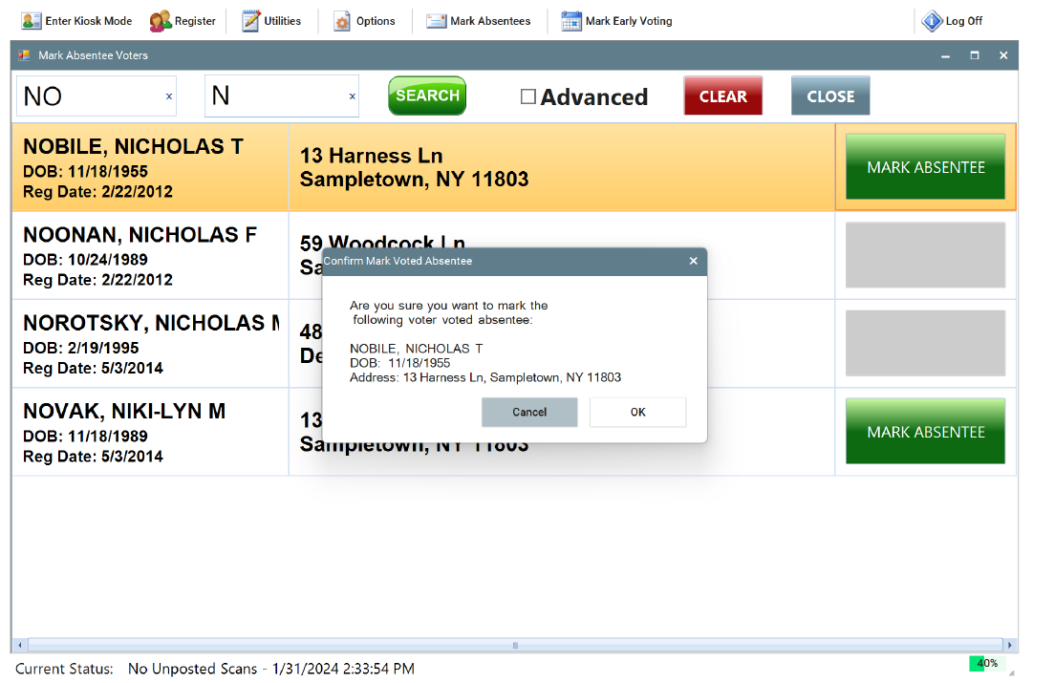
[To combine with early voters]
EMS User-Interface Overview: Absentee Voters
Designed for every role in your election team, Bold empowers every election official throughout the process
Absentee Tracking
Bold’s EMS allows users to pre-mark voters as absentee before Election Day. Once marked, the absentee status is instantly visible to poll workers at check-in
Simple Process
Visible at Check-In
Prevents Double Voting
Included in Reports
Marking absentee voters keeps the check-in process smooth and secure. Voter records are clearly labeled and locked, preventing errors and helping your team maintain clean election data

Slide 29
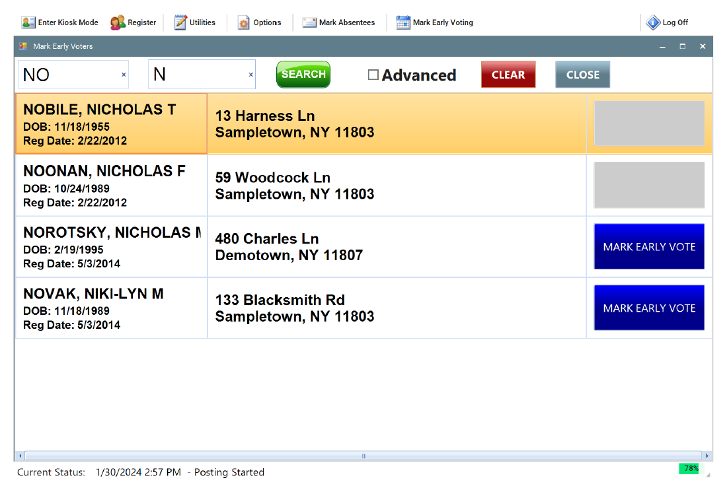
[To combine with absentees]
EMS User-Interface Overview: Early Voters
Designed for every role in your election team, Bold empowers every election official throughout the process
Early Voter Tracking
Users can easily mark voters as early in Bold’s EMS before election day. That status is instantly visible to poll workers during check-in ensuring accurate records and preventing duplicate voting
Simple Process
Visible at Check-In
Prevents Double Voting
Included in Reports
Early vote tracking in EMS gives your election team full visibility and prevents duplicate voting. It’s seamless for poll workers and built to maintain record integrity across all voter statuses

Slide 30






[Brandon to reformat]
Bold’s Election Management System at a Glance
Purpose-built for your team, Bold streamlines every step of the voter check-in process from setup to reporting
One Complete EMS Solution
Bold’s EMS powers every phase of your election from setup to sign-off with the reliability, speed, and support you deserve
Pre-Election Setup
Post-Election & Reporting
Bold’s comprehensive pre-election tools streamline the setup process and ensure a seamless start to Election Day
Bold simplifies your post-election closeout with tools to reconcile poll lists, track voter history, and generate audit-ready reports in minutes
On Election Day
Support & Training
Bold keeps Election Day running smoothly with intuitive check-in tools, built-in fail-safes, real-time reporting, and regional poll reps ready to support your team on-site
Bold is with you at every step, offering unlimited training, live support, and election-tested guidance to keep your team confident and in control

